Slide 1
Computer Graphics: Line Drawing Algorithms
Scan Conversion Algorithms
(Midpoint Line)

Slide 2
7
6
5
4
Midpoint
3
2
0
1
2
3
4
5
6
7

Slide 4




(2, 4)
(2, 3)
(2, 2)

Slide 5



Slide 8
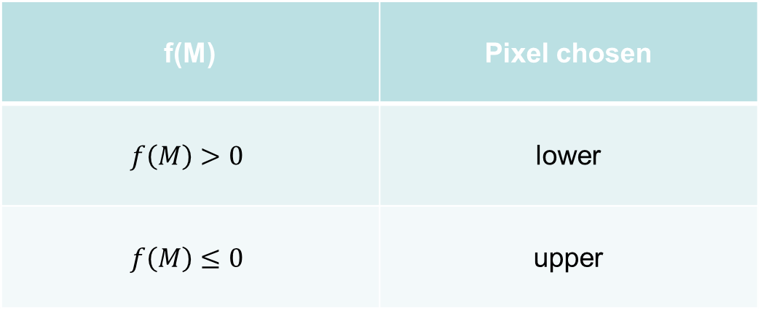
f(M) | Pixel chosen
 | upper
 | lower

Slide 9









Slide 10






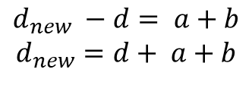

$$d>0, so NE is chosen$$

Slide 11










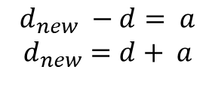


$$d≤0, so E is chosen$$
$$M_{2}$$

Slide 12
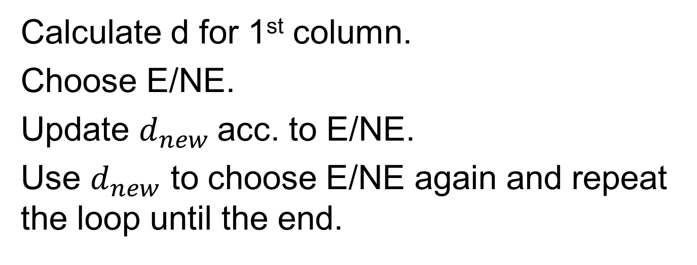
Calculate d for 1st column.
Choose E/NE.
Update $d_{new}$acc. to E/NE.
Use $d_{new}$ to choose E/NE again and repeat the loop until the end.

Slide 13

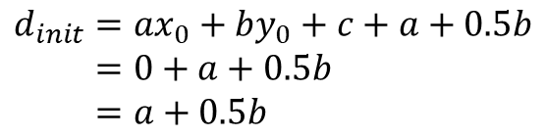


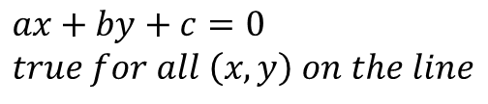
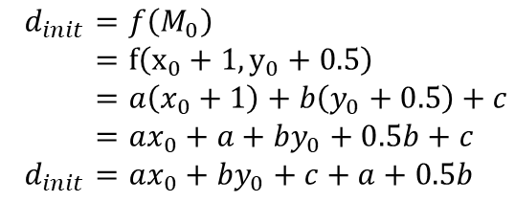
7
$$d_{init}=f\left(M_{0}\right) \\ =f\left(x_{0}+1, y_{0}+0.5\right) \\ =a\left(x_{0}+1\right)+b\left(y_{0}+0.5\right)+c \\ =ax_{0}+a+by_{0}+0.5b+c \\ d_{init}=ax_{0}+by_{0}+c+a+0.5b$$
6
5
4
$$ax+by+c=0 \\ true for all \left(x,y\right) on the line$$
Midpoint
3
$$M_{0}(x_{0}+1,y_{0}+0.5)$$
$$So, ax_{0}+by_{0}+c=0$$
2
$$(x_{0},y_{0})$$
$$d_{init}=ax_{0}+by_{0}+c+a+0.5b \\ =0+a+0.5b \\ =a+0.5b$$
0
1
2
3
4
5
6
7

Slide 14
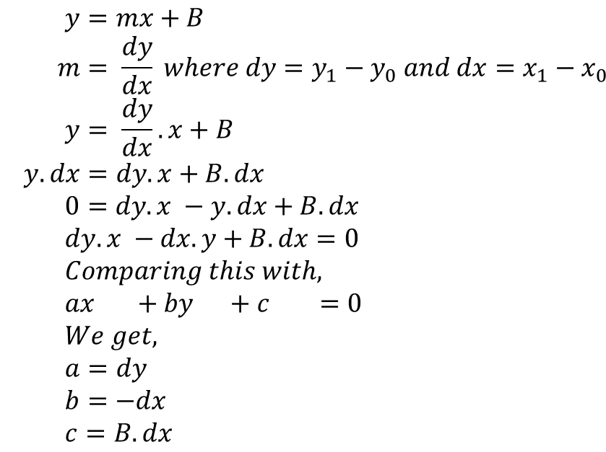



$$(x_{1},y_{1})$$
$$y=mx+B \\ m= \frac{dy}{dx} where dy=y_{1}−y_{0} and dx=x_{1}−x_{0} \\ y= \frac{dy}{dx}.x+B \\ y.dx=dy.x+B.dx \\ 0=dy.x −y.dx+B.dx \\ dy.x −dx.y+B.dx=0 \\ Comparing this with, \\ ax +by +c =0 \\ We get, \\ a=dy \\ b=−dx \\ c=B.dx$$
$$dy=y_{1}−y_{0}$$
$$(x_{0},y_{0})$$
$$dx=x_{1}−x_{0}$$

Slide 15





$$d=d_{init} \\ =a+0.5b$$
$$is d>0?$$
yes
no
$$Choose NE as next pixel \\ d ←d+a+b$$
$$Choose E as next pixel \\ d ←d+a$$
$$Check if current pixel is (x_{1},y_{1})$$
no
yes
end

Slide 16
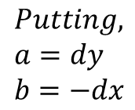
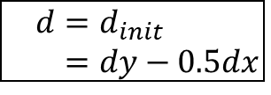
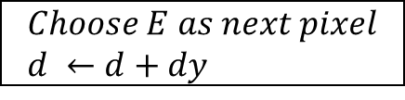
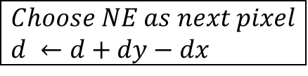
$$d=d_{init} \\ =dy−0.5dx$$
$$Putting, \\ a=dy \\ b=−dx$$
$$is d>0?$$
yes
no
$$Choose NE as next pixel \\ d ←d+dy−dx$$
$$Choose E as next pixel \\ d ←d+dy$$
$$Check if current pixel is (x_{1},y_{1})$$
no
yes
end

Slide 17
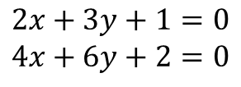
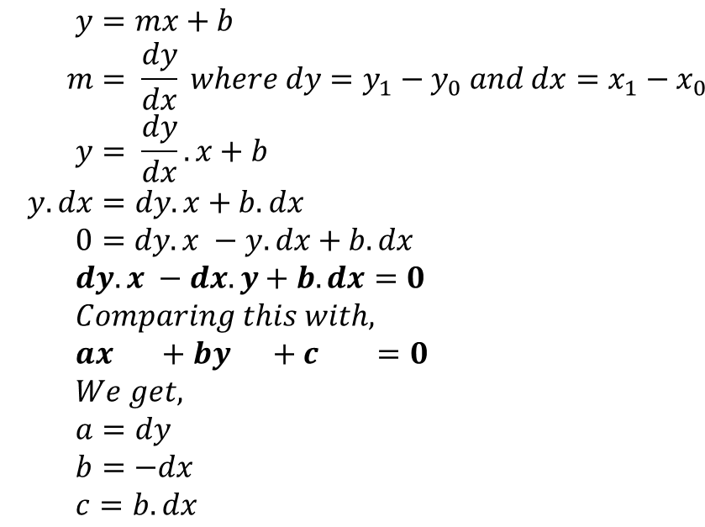
$$(x_{1},y_{1})$$
$$y=mx+b \\ m= \frac{dy}{dx} where dy=y_{1}−y_{0} and dx=x_{1}−x_{0} \\ y= \frac{dy}{dx}.x+b \\ y.dx=dy.x+b.dx \\ 0=dy.x −y.dx+b.dx \\ dy.x −dx.y+b.dx=0 \\ Comparing this with, \\ ax +by +c =0 \\ We get, \\ a=dy \\ b=−dx \\ c=b.dx$$
$$dy=y_{1}−y_{0}$$
$$(x_{0},y_{0})$$
$$dx=x_{1}−x_{0}$$
$$2x+3y+1=0 \\ 4x+6y+2=0$$

Slide 18
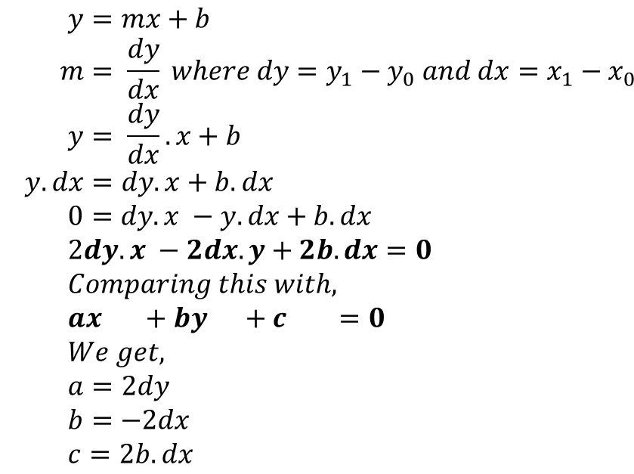
$$(x_{1},y_{1})$$
$$y=mx+b \\ m= \frac{dy}{dx} where dy=y_{1}−y_{0} and dx=x_{1}−x_{0} \\ y= \frac{dy}{dx}.x+b \\ y.dx=dy.x+b.dx \\ 0=dy.x −y.dx+b.dx \\ 2dy.x −2dx.y+2b.dx=0 \\ Comparing this with, \\ ax +by +c =0 \\ We get, \\ a=2dy \\ b=−2dx \\ c=2b.dx$$
$$dy=y_{1}−y_{0}$$
$$(x_{0},y_{0})$$
$$dx=x_{1}−x_{0}$$

Slide 19
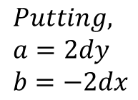
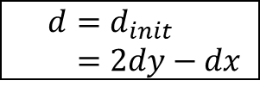
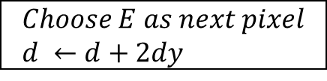
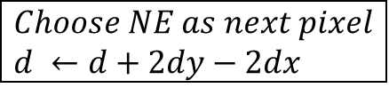
$$d=d_{init} \\ =2dy−dx$$
$$Putting, \\ a=2dy \\ b=−2dx$$
$$is d>0?$$
yes
no
$$Choose NE as next pixel \\ d ←d+2dy−2dx$$
$$Choose E as next pixel \\ d ←d+2dy$$
$$Check if current pixel is (x_{1},y_{1})$$
no
yes
end

Slide 20
Algorithm
func MidpointLine(int x0, int y0, int x1, int y1, int value){
int dx, dy, incrE, incrNE, d, x, y;
dx = x1 -x0;
dy = y1 -y0;
d = 2 * dy - dx;
incrE = 2 * dy;
incrNE = 2 * (dy - dx);
x = x0;
y = y0;
WritePixel (x, y, value);
while (x < x1) {
if (d <= 0) {
//choose E
d = d + incrE;
x = x + 1;
}
else {
//choose NE
d = d + incrNE;
x = x + 1;
y = y + 1;
}
WritePixel (x,y, value) //The selected pixel closest to the line
}
}

